Slide 1
Project Progress Presentation
BLG 506E – COMPUTER VISION
BURAK BOZDAĞ - 504211552

Slide 2
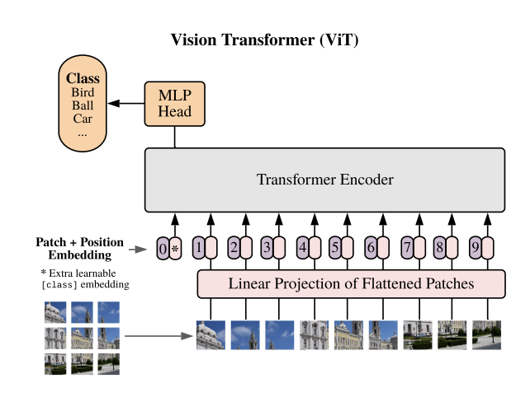
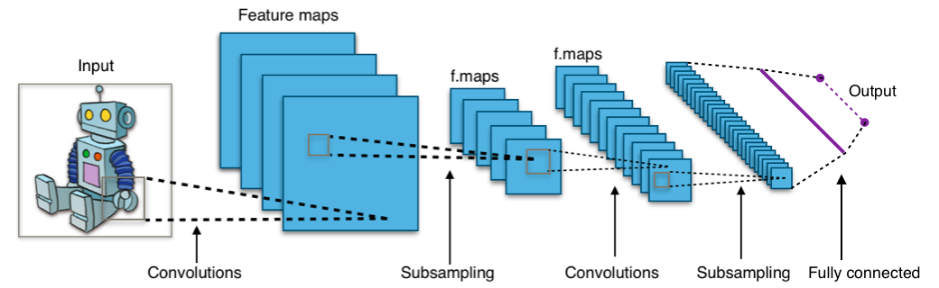
Recap: About the Project
Classifying Chest X-Ray Images Using CNN and Transformer Based Architectures
Comparing CNN and transformer models for classifying patients as normal or infected
CNN

Slide 3


Applied Processes and Methods
TensorFlow, Keras
Examining Dataset
Data Augmentation
ViT Evaluation

Slide 4

Test Bench
AMD Radeon RX 6600 XT 8GB
16 GB RAM
tensorflow-cpu==2.10
tensorflow-directml-plugin
Enable GPU Acceleration for TensorFlow 2 with tensorflow-directml-plugin [1]

Slide 5
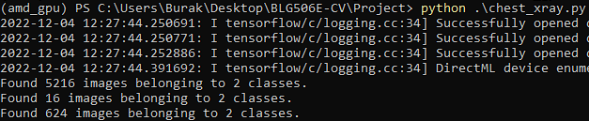
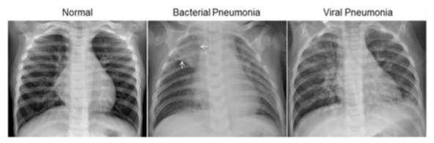
Dataset
Chest X-Ray Images (Pneumonia) [2]
5856 JPEG images (1.15 GB)
5216 train
16 validation
624 test

Slide 6
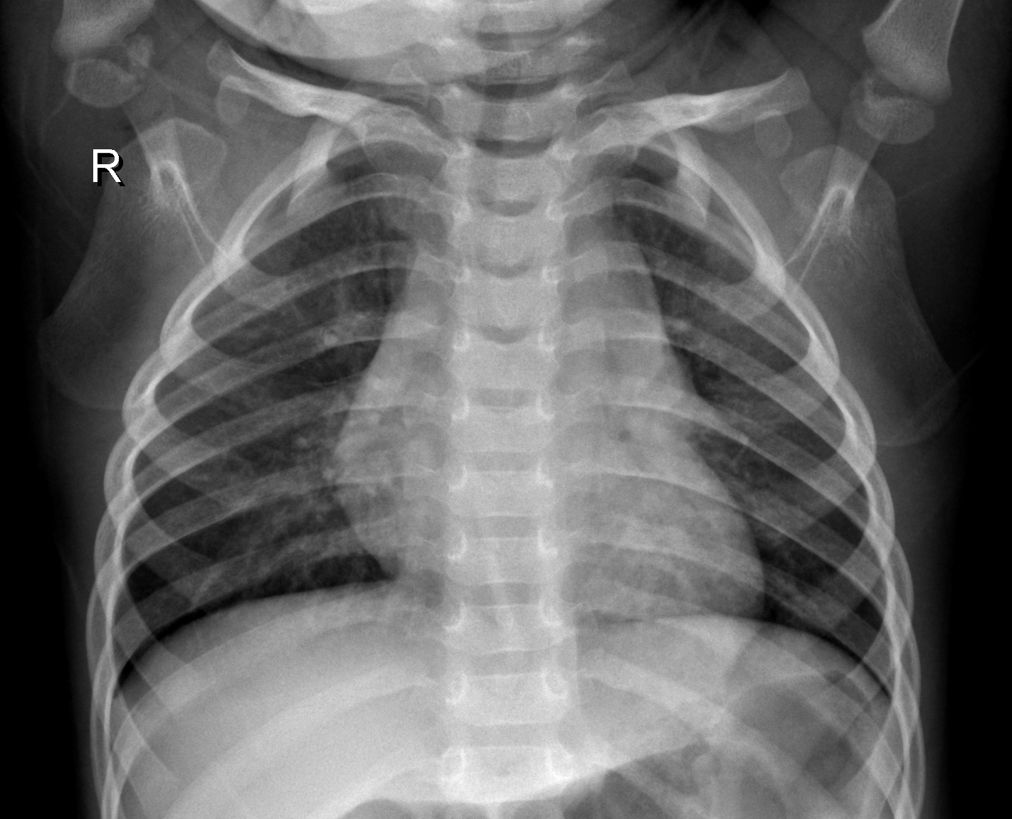
Data Augmentation
Rescale = 1/255
Zoom Range = 0.1
Rotation Range = 0.2
Horizontal-Vertical Flip
224x224 WxH
Notes:
Keras.preprocessing ImageDataGenerator
Rescaling is also done on the test set
Rotation is in terms of degrees
To prevent overfitting

Slide 7
ViT Evaluation
Callbacks:
Monitoring Validation Loss
Reduce LR
Early Stopping
Model Checkpoint
ViT-B/16 architecture
Layers: Input, Conv2D, Reshape, 12 x Transformer Encoders, Normalization, Lambda, Dense
Pre-trained model with ImageNet 2012
Notes:
Keras.callbacks: ReduceLROnPlateau, EarlyStopping, ModelCheckpoint
18 layers, no frozen layers, all trainable

Slide 8

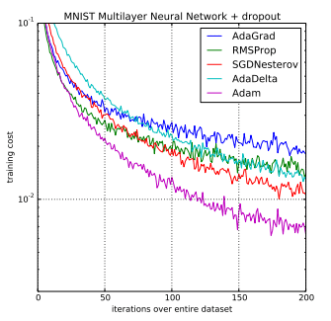
ViT Evaluation
Optimizer: Adam
Loss: Binary Cross-Entropy
Max. # of 50 Epochs
Notes:
Optimizer: Adam
Loss: Binary Cross-Entropy because there are only 2 classes

Slide 9
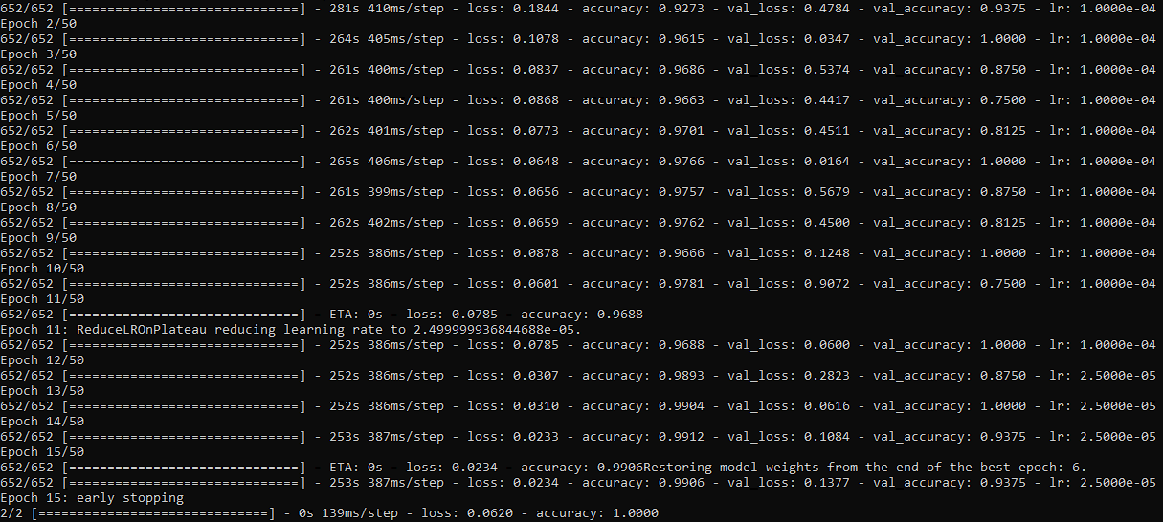

Slide 10
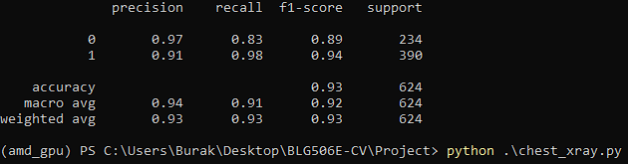
Results
0: Healthy
1: Pneumonia
Accuracy: 0.93
Notes:
Sklearn.metrics classification_report

Slide 11
Remaining Work
Setting up a traditional CNN model
Comparing CNN and ViT
Multi-class classification (viral-bacterial infection)
Merging other datasets (Tuberculosis, COVID-19)

Slide 12
References
[1] “Enable GPU Acceleration for TensorFlow 2 with tensorflow-directml-plugin,” DirectML Plugin for TensorFlow 2 | Microsoft Learn, 2022. [Online]. Available: https://learn.microsoft.com/en-us/windows/ai/directml/gpu-tensorflow-plugin.
[2] D. S. Kermany, et al., Identifying Medical Diagnoses and Treatable Diseases by Image-Based Deep Learning, 2018. [Online]. Available: https://www.cell.com/cell/fulltext/S0092-8674(18)30154-5.

